Slide 1

Soda Formulation Review Quiz
Submit a UML diagram as answers to the questions in this quiz in the form of a JPG, PNG or PDF file. Please name each file LastNameFirstNameQuestion# and include a file extension. This is how you’ll submit them for the actual exams and it will help us grade.
You are not expected to run the code provided for these questions. The code does not need to be run in order to answer the questions, they have been provided as a reference to give you the best understanding of questions' context.
The code has been written without following many of the recommendations of this course. Your assignment is to take a look at the code provided, see how it has been designed, then refactor the design and provide a UML diagram showing your new, refactored design. You are not expected to submit code in your solution, you are only expected to submit the answer as a UML class diagram. Your UML must show all classes, methods, parameters, return values, attributes, data types, and scope for elements needed in your solution.
Continue
Notes:
Submit a UML diagram as answers to the questions in this quiz in the form of a JPG, PNG or PDF file. Please name each file LastNameFirstNameQuestion# (In this case 1) and include a file extension. This is how you’ll submit them for the actual exams and it will help us grade.
You are not expected to run the code provided for these questions. The code does not need to be run in order to answer the questions, they have been provided as a reference to give you the best understanding of questions' context.
The code has been written without following many of the recommendations of this course. Your assignment is to take a look at the code provided, see how it has been designed, then refactor the design and provide a UML diagram showing your new, refactored design. You are not expected to submit code in your solution, you are only expected to submit the answer as a UML class diagram. Your UML must show all classes, methods, parameters, return values, attributes, data types, and scope for elements needed in your solution.

Slide 2
Soda Formulation Review Quiz
Note that, you are not expected to match the interface of the provided code. You are free to refactor the problem completely as long as you maintain the same overall functionality. Some problems are best solved using the design patterns you have learned in class, others do not require the use of design patterns.
To get full credit for a problem, you must determine if any design patterns are appropriate and if so, indicate which indicates design patterns you utilized and what classes represent the components of the design pattern within the UML as either a note or text annotation.
Please download the zip file (SodaFormulation.zip) which contains the improper code and when complete submit the UML.
Continue
Notes:
Note that, you are not expected to match the interface of the provided code. You are free to refactor the problem completely as long as you maintain the same overall functionality. Some problems are best solved using the design patterns you have learned in class, others do not require the use of design patterns.
To get full credit for a problem, you must determine if any design patterns are appropriate and if so, indicate which indicates design patterns you utilized and what classes represent the components of the design pattern within the UML as either a note or text annotation.
Please download the zip file (SodaFormulation.zip) which contains the improper code and when complete submit the UML.

Slide 3
Soda Formulation Review Quiz
A long time ago, Professor Salvage was a co-op student and bought a can of Coke. It had a Kosher for Passover stamp on it. He was puzzled. He knew that Coke had corn syrup as one of its ingredients, but corn syrup is not allowed during Passover. So, he called Coke and asked what was up with that! The company explained that the label listed corn syrup and or cane sugar as ingredients. Apparently, when they made a blend of Coke for Passover, the company changed the ingredients (from corn syrup to sugar) and added a Kosher for Passover stamp to the can, but didn’t have to change the ingredients on the can label, because of nifty labeling.
Continue
Notes:
A long time ago, Professor Salvage was a co-op student and bought a can of Coke. It had a Kosher for Passover stamp on it. He was puzzled. He knew that Coke had corn syrup as one of its ingredients, but corn syrup is not allowed during Passover. So, he called Coke and asked what was up with that! The company explained that the label listed corn syrup and or cane sugar as ingredients. Apparently, when they made a blend of Coke for Passover, the company changed the ingredients (from corn syrup to sugar) and added a Kosher for Passover stamp to the can, but didn’t have to change the ingredients on the can label, because of nifty labeling.

Slide 4
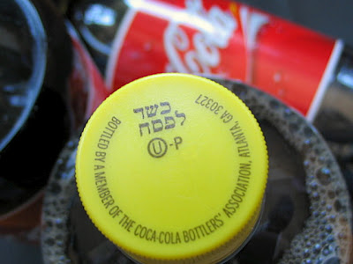
Soda Formulation Review Quiz
That’s the background for this question. Observe the PassoverExample.java code and its related files that simulates that switch in ingredients. Your assignment is to refactor the design of the code and create a UML diagram showing your new design.
Additionally, you should show how your solution interacts with the external library (net.sourceforge.zmanim.hebrewcalendar.JewishDate). You don’t need to show every method or attribute in the library, just the public interface you would use in your solution.
Continue
Notes:
That’s the background for this question. Observe the PassoverExample.java code and its related files that simulates that switch in ingredients. Your assignment is to refactor the design of the code and create a UML diagram showing your new design.
Additionally, you should show how your solution interacts with the external library for the Jewish date. You don’t need to show every method or attribute in the library, just the public interface you would use in your solution.
https://www.vosizneias.com/wp-content/uploads/2012/04/passover-coke-003.jpg

Slide 5
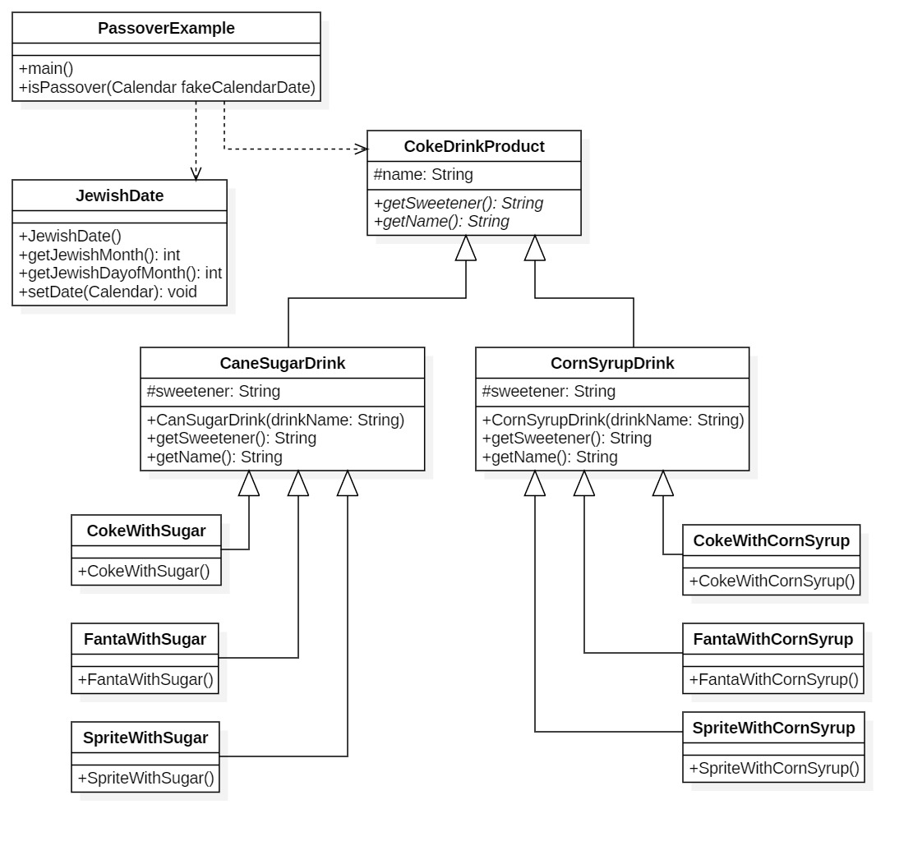
Soda Formulation Review Quiz
What’s wrong with the original solution?
Continue
Notes:
The main problem with the original solution is that the choice of sweetener is encapsulated with the choice of flavor. Therefore, if we were to create a new flavor, we’d have to add two new classes. One for each type of sweetener. Similarly, if we add a new sweetener, we need to add three classes, one for each flavor. Obviously, there are many flavors and types of sweeteners in the real world, so we would get an explosion of classes.

Slide 6

Soda Formulation Review Quiz
Which design pattern is appropriate to solve this problem?
No Pattern
Facade
Adapter
Strategy
Bridge
Notes:
So which design pattern did you use to solve the problem? So far, we’ve learned the Façade, Adapter, Strategy and the Bridge. Also, you could try to solve it without a pattern. Click on the appropriate choice.
https://images.app.goo.gl/ygfjj6bykuJwjpLm9

Slide 7

Soda Formulation Review Quiz – No Pattern
Try again, you can definitely apply a design pattern to refactor this problem.
Return to
Choices Screen
Notes:
Try again, you can definitely apply a design pattern to refactor this problem.
Click on the Return to Previous Screen button to continue.
https://www.inverse.com/article/54687-star-wars-episode-9-leaks-rey-origins-may-change-from-last-jedi

Slide 8

Soda Formulation Review Quiz - Facade
The façade design pattern does not help solve this problem. You must reach out to other solutions.
Return to
Choices Screen
Notes:
The façade design pattern does not help solve this problem. You must reach out to other solutions.
A common mistake is to call any encapsulation of a class a façade.
A façade is used when there is a complex subsystem and you wish to make a subset of the functionality available through a simplified interface.
Here there is no subsystem and all the functionality is needed.
https://www.inverse.com/article/54687-star-wars-episode-9-leaks-rey-origins-may-change-from-last-jedi

Slide 9

Soda Formulation Review Quiz - Adapter
The adapter design pattern does not help solve this problem. Try again.
Return to
Choices Screen
Notes:
The adapter design pattern does not help solve this problem. You must try other solutions.
An adapter is used when you have an existing class or set of classes with a defined interface. We certainly have that here. It is utilized when another class is needed and its functionality is provided by a class who has the right features, but the wrong interface. This problem is not an issue of adding a class and thus the use of an adapter does not apply.
https://www.pinterest.com/pin/862157922395748007/

Slide 10

Soda Formulation Review Quiz - Strategy
Good Job!
A strategy is the right pattern to use. Click Continue to see how we apply it.
Continue
Notes:
Good Job!
A strategy is the right pattern to use. Click Continue to see how we apply it.
https://www.pinterest.com/pin/757238124833944698/

Slide 11
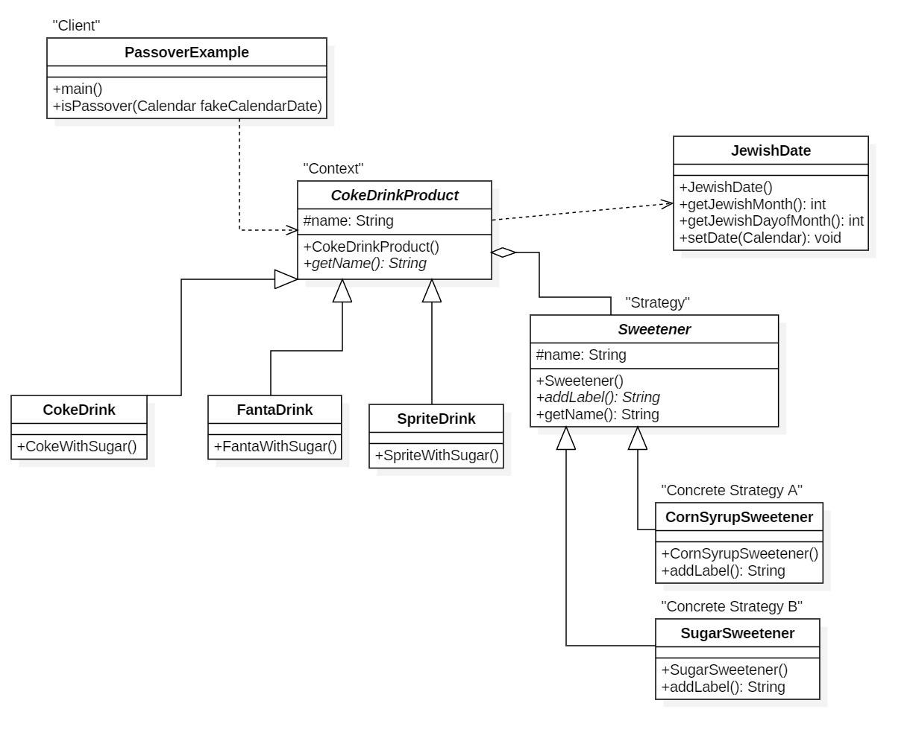
Soda Formulation Review Quiz
The ideal solution is to use a Strategy pattern.
Return to
Choices Screen
Notes:
The ideal solution is to use a strategy pattern.
The client is the class Passover Example which uses a CokeDrinkProduct.
This way we abstract the different aspects of a Coke drink that vary independently.
The two aspects that vary are the general flavor of the drink, ie. whether it is a Coke, Fanta or Sprite. Then the other variation is the type of sweetener.
In both cases, we have a few choices, but could have many many more.
Therefore, we can use the CokeDrinkProduct as the Context of the strategy. We can have variations of that context with a CokeDrink, FantaDrink, and SpriteDrink.
The strategy this case is the Sweetener.
It is aggregated into the Context thus any CokeDrinkProduct can have any Sweetener. Thus the type of CokeDrinkProduct varies independently from the Sweetener.
The concrete strategies are CornSyrupSweetner and SugarSweetener.
Return the Patterns screen and explore the other answers to further understand any subtleties with this example.

Slide 12

Soda Formulation Review Quiz - Bridge
Almost. You might think the Bridge is the correct solution, click the Continue button to see why it is not.
Continue
Notes:
Almost. You might think the Bridge is the correct solution, click the Continue button to see why it is not.
https://www.pinterest.com/pin/757238124833944698/

Slide 13
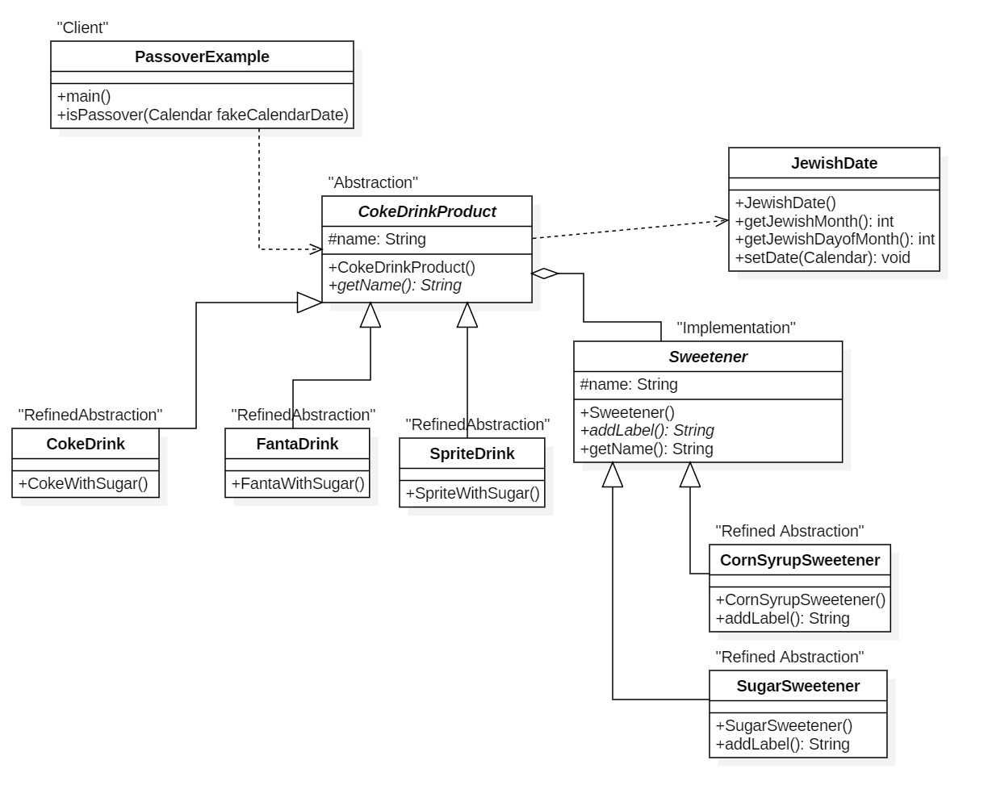
Soda Formulation Review Quiz
Bridge
X X
Return to
Choices Screen
Notes:
A bridge isn’t the correct pattern, because although we have abstractions and refined abstractions, we do not have an implementation and refined concrete implementations.
Instead we have a Sweetener which is just an ingredient of a CokeDrinkProduct.
In essence it’s another abstraction and set of refined abstractions.

